Slide 1
Practice Session 4
Right Here Right Now

Slide 2
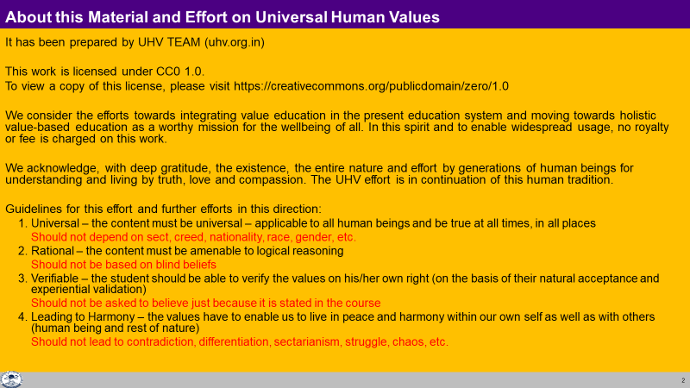

Slide 3
Right Here Right Now
Watch the video Right Here Right Now
A short film about human behavior and its propagation. It is directed by Anand Gandhi
Source:
Part 1: https://www.youtube.com/watch?v=OVAokeqQuFM
Part 2: https://www.youtube.com/watch?v=gIYJePEnvUY
We will discuss your observations:
Interactions with each other – reaction or response
The basis of deciding
  – motivated by preconditioning
  – motivated by sensation
  – by self verification based on their natural acceptance
3. Are the actions indicating right understanding, trust?

Slide 4
Discussion
Even a single happy person has an impact on others
Similarly an unhappy person has an impact on others

Slide 5
Response Reaction
You decide your feeling on your own right | You decide your feeling based on the behaviour of the other
It is on the basis of your natural acceptance, right understanding You always have the right feeling It is definite and unconditional The behavior of the other is only an indicator of the state of the other With that input you decide your behaviour to ensure mutual happiness | It depends on whether you like or dislike the (taste of the) behaviour of the other If the other behaves properly, you have a right feeling and may behave properly If the other misbehaves, you have a wrong feeling and you may also misbehave
You decide your own behaviour You are self-organised | Your “remote control” is with the others You are enslaved
Your conduct is definite ( | Your conduct is indefinite

Slide 6
Self Reflection
In your own interactions, find out
  the % time you are responding
  the % time you are reacting
What is the effort required to progress from reaction to response?
To develop the right understanding (at least about relationship)
To be aware of the other's natural acceptance and evaluate their competence while interacting
To live with responsibility with the other unconditionally

Slide 7
What do the events indicate – lack of Intention or lack of Competence?
Event: The boy shouts back at his mother
Find out if it is
Lack of intention – He intended to make his mother unhappy, so he shouted back
or
Lack of competence – He was disturbed, his natural acceptance (intention) was to make his mother happy but he lacked the competence to communicate properly, so he shouted back (lack of competence)
Event: The doctor did not reach on time to where Shruti was waiting
Find out if it is
Lack of intention – He intended to make Shruti unhappy, and help the accident victim
Lack of competence – He intended to make Shruti happy, and he also intended to help the accident victim. He lacked the competence to inform Shruti in such an emergency. He had to choose between a dn b, and in the situation, he choose b
a) Reaching Shruti on time and ignoring the accident victim
b) First taking care of the accident victim, then reaching Shruti and sharing his rationale

Slide 8
On what basis are people deciding – Preconditioning, Sensation or Natural Acceptance?
Decisions are motivated by preconditioning
Decisions are motivated by sensation
Decisions are on the basis of self verification based on their natural acceptance
Eg.
On what basis did the grandmother decide that it is OK for Shruti to marry the doctor?
Why did the boy say “I love you” to Chahat
Why did the doctor decide to pick up the accident victim, even though he was getting late to meet Shruti?

Slide 9

Intention and Desire not same. Desire is a part of Competence. Intention = Natural Acceptance
 | Force / Power cy@“kfDr | Activity fØz;k
1. |  | Realization vuqHko
2. |  | Understanding cks/k
3. | Desire bPNk | Imaging fp=.k
4. | Thought fopkj | Analysing fo'ys"k.k
5. | Expectation vk'kk | Selecting/Tasting p;u@vkLoknu
Natural Acceptance
INTENTION
3
Preconditioning
ekU;rk
1
COMPETENCE
What You Are
Imagination
dYiuk”khyrk
Body 'kjhj
2
Sensation
Lakosnuk
Behaviour O;ogkj
Work dk;Z
All desires are not motivated by natural acceptance (most are motivated by preconditioning or sensation)

Slide 10
Similarly analyse these events:
Event: You came late to the workshop
Analysis: You wanted to come late (intention or desire?)
You could not reach on time (lack of competence)
You want to understand what is right and do what is right (intention)
Event: Someone takes away your mobile
Analysis: She wanted to take your mobile (intention or desire)
She thinks the main source of happiness is physical facility
and she does not see her relationship with you (lack of competence)
Event: A terrorist kills some people
Analysis: He wanted to kill people (intention or desire)
He could not find a way to resolve his contradictions
inspite of 20 years of education (lack of competence)

Slide 11
How do you decide?
Are your decisions motivated by preconditioning? What %?
Are your decisions motivated by sensation? What %
What % of your decisions are on the basis of self verification, based on your natural acceptance?
Do you want that all your decisions should be motivated by your natural acceptance? What do you need to do to ensure it?

